Slide 1
Advances in SENSE with Arbitrary k-Space Trajectories
Jaeeun Lee
2018/01/08

Slide 2
Contents
Gridding
PSF
Brain image
Deappodization
CG loop
Miscellanea
Numerical Phantom Gridding
Look-Up Table
Size of image

Slide 3
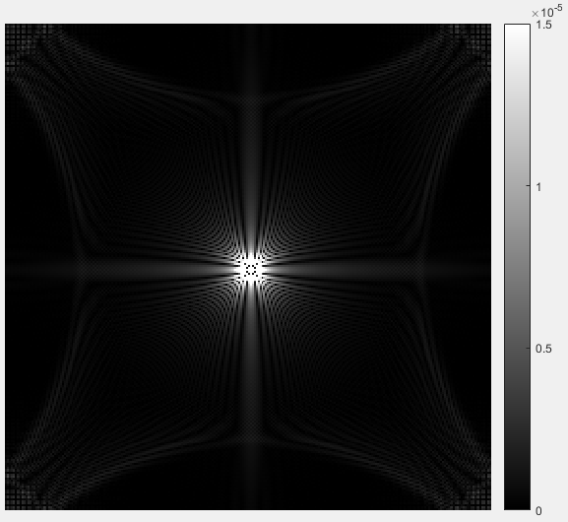
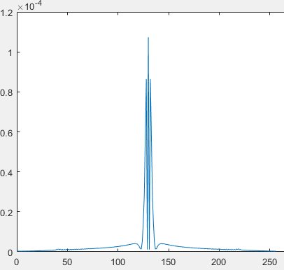
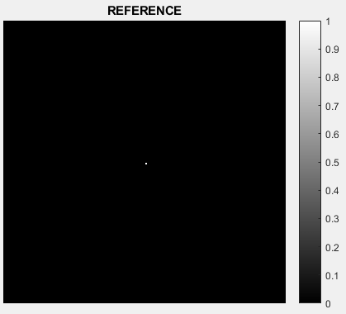
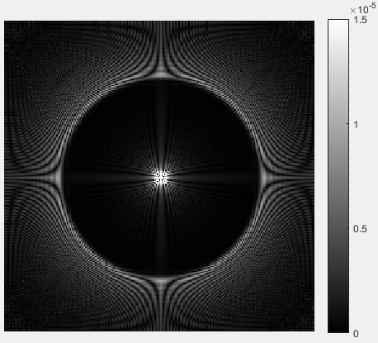
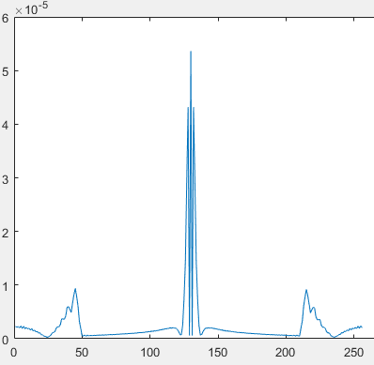
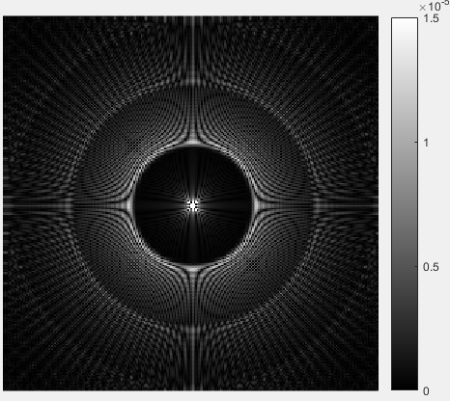
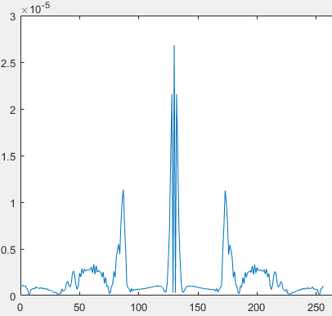
Gridding_ 1)PSF
[Spoke = 512]
[Spoke = 256]
Sampling parameters
- Image size = [256 X 256]
[Spoke = 128]
Gridding parameters
- Oversampling factor = 1
- Kernel width = 3
- Kernel constant = 7

Slide 4
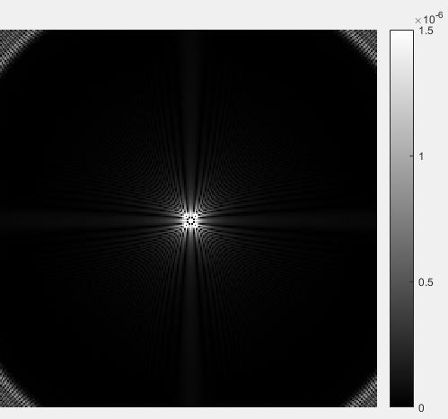
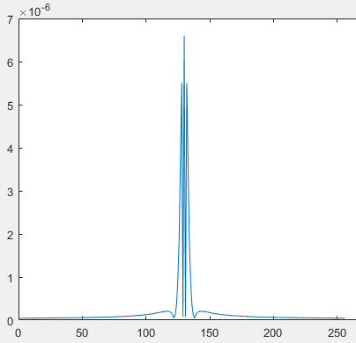
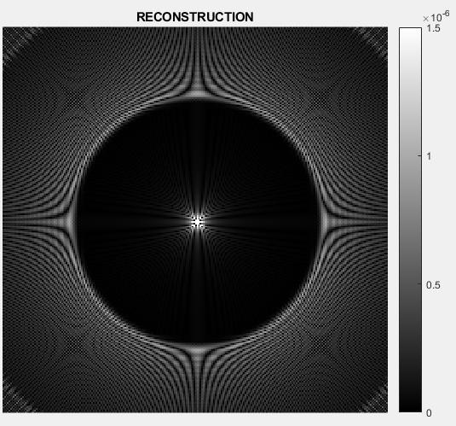
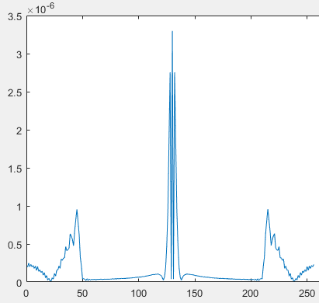
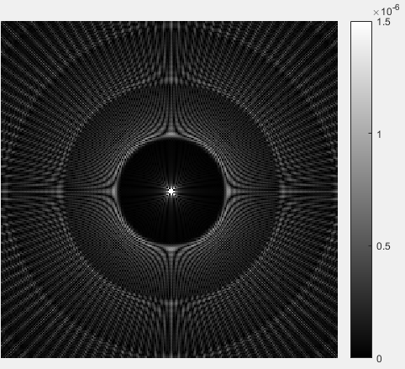
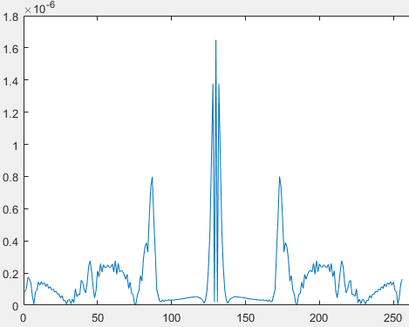
Gridding_ 1)PSF
[Spoke = 512]
[Spoke = 256]
Sampling parameters
- Image size = [256 X 256]
[Spoke = 64]
Gridding parameters
- Oversampling factor = 2
- Kernel width = 3
- Kernel constant = 7

Slide 5
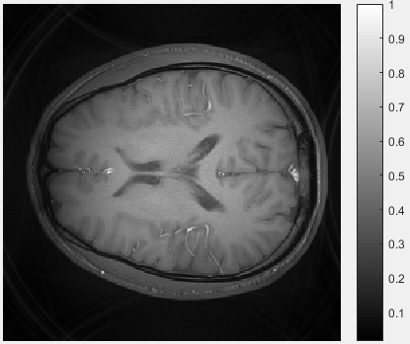
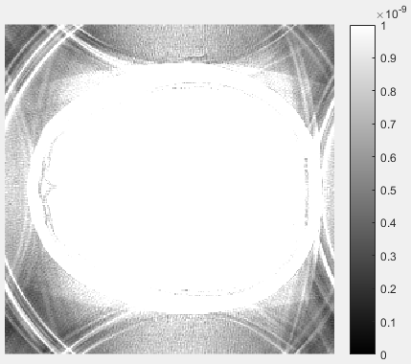
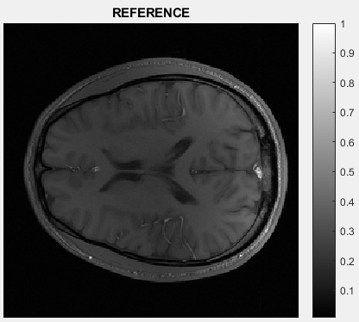
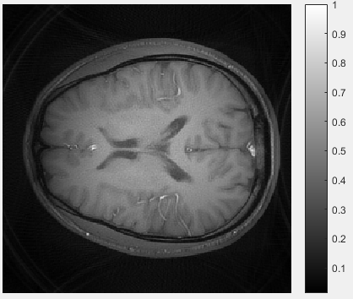
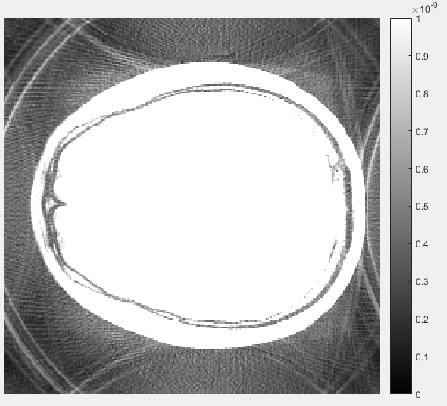
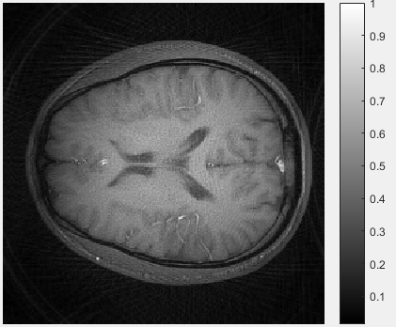
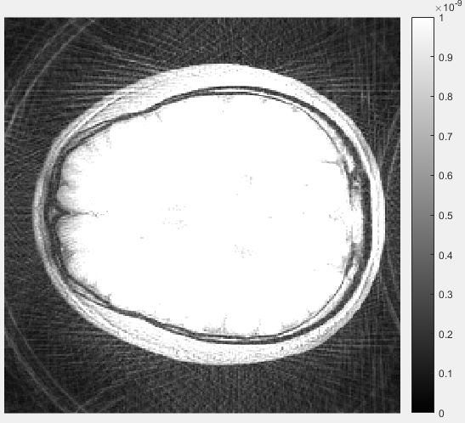
Gridding_ 2)Brain Image
[Spoke = 512]
[Spoke = 256]
Sampling parameters
- Image size = [256 X 256]
[Spoke = 128]
Gridding parameters
- Oversampling factor = 1
- Kernel width = 3
- Kernel constant = 7

Slide 6
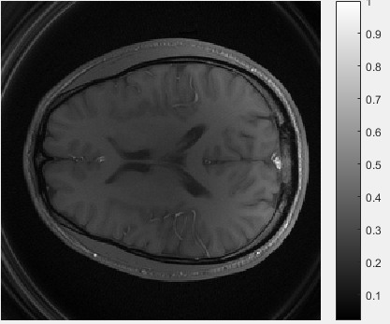
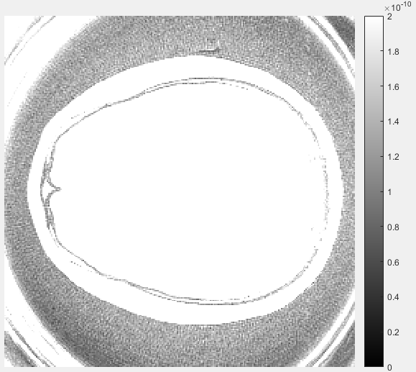
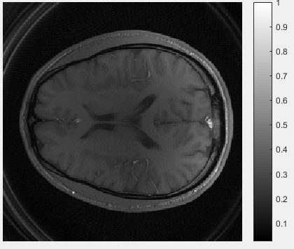
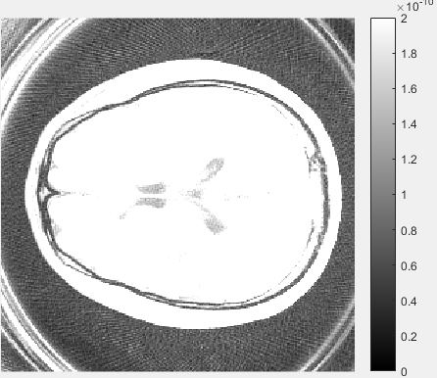
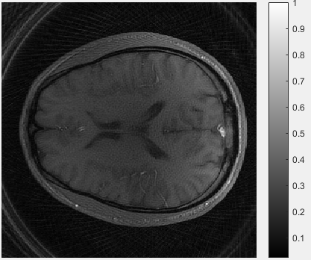
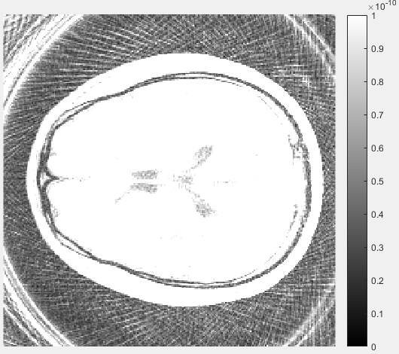
Gridding_ 2)Brain Image
[Spoke = 512]
[Spoke = 256]
Sampling parameters
- Image size = [256 X 256]
[Spoke = 128]
Gridding parameters
- Oversampling factor = 2
- Kernel width = 3
- Kernel constant = 7

Slide 7
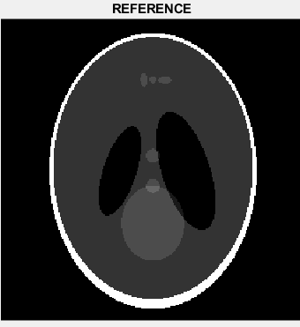

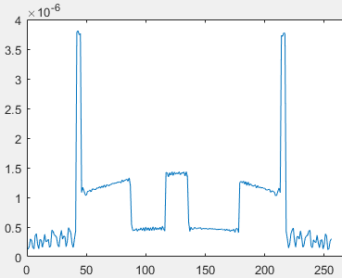
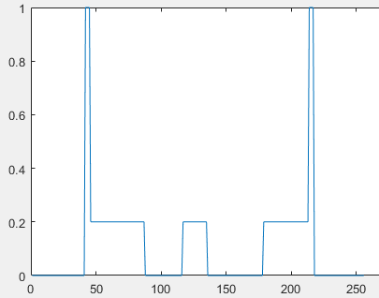

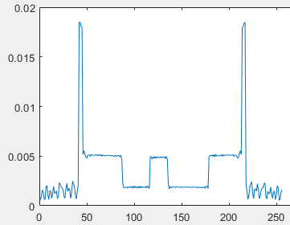
Gridding_ 3)Deappodization
[No deappodization]
[deappodization kernel size]
[Center line profile]
Sampling parameters
- Image size = [256 X 256]
- Spoke = 512
Gridding parameters
- Oversampling factor = 2
- Kernel width = 3
- Kernel constant = 7
[256 + eps(0.01)]

Slide 8
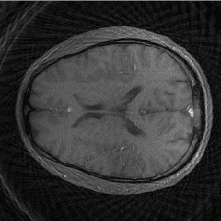
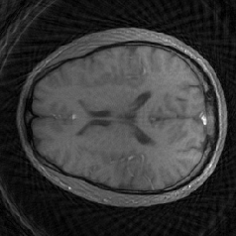
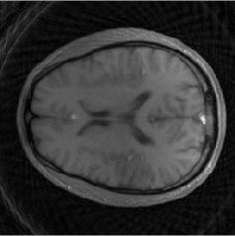
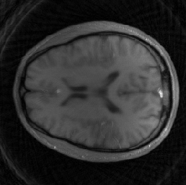


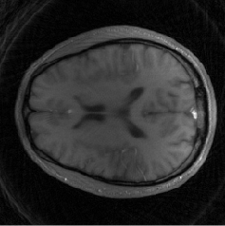



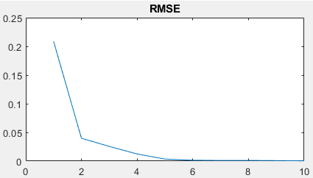
CG Loop
[1]
[2]
[3]
[4]
[5]
[iteration]
[6]
[7]
[8]
[9]
[10]
Sampling parameters
- Image size = [256 X 256]
- Reduction factor = 4
Gridding parameters
- Oversampling factor = 2
- Kernel width = 3
- Kernel constant = 7

Slide 9
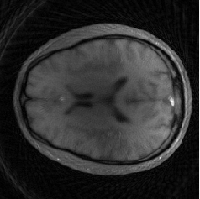
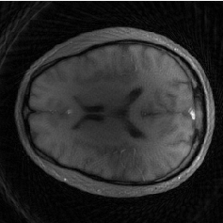
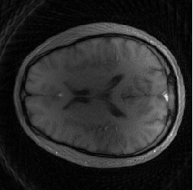
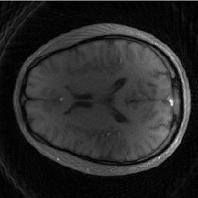

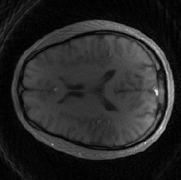
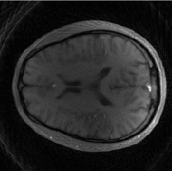
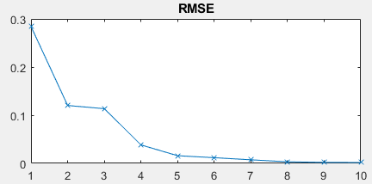
CG Loop
[2]
[2]
[3]
[3]
[4]
[4]
[5]
[1]
[5]
[1]
[iteration]
[7]
[7]
[8]
[8]
[9]
[9]
[10]
[6]
[10]
[6]
Sampling parameters
- Image size = [256 X 256]
- Reduction factor = 4
Gridding parameters
- Oversampling factor = 2
- Kernel width = 5
- Kernel constant = 7

Slide 10

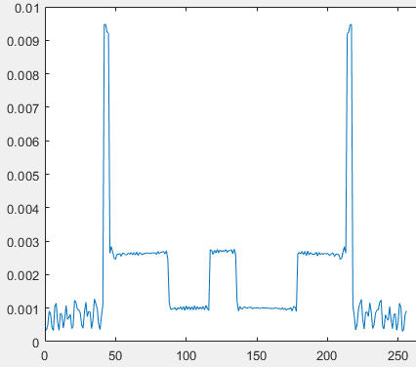
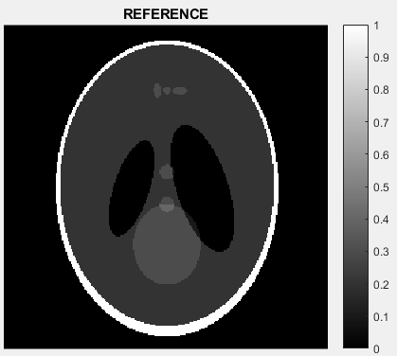

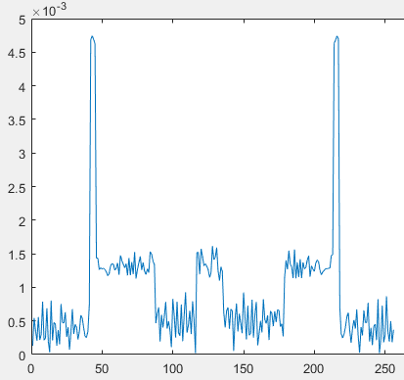
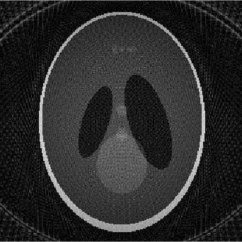
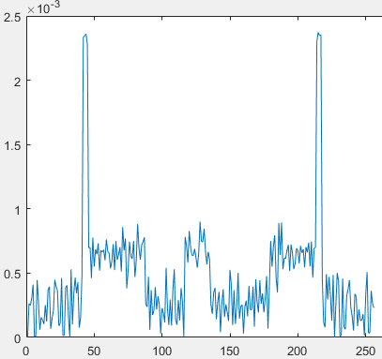
Miscellanea_ 1)Numerical Phantom Gridding
[Spoke = 512]
[Spoke = 256]
Sampling parameters
- Image size = [256 X 256]
Gridding parameters
- Oversampling factor = 2
- Kernel width = 3
- Kernel constant = 7
[Spoke = 64]
REF: Bernstein, M. A., King, K. F., & Zhou, X. J. (2005). Handbook of MRI pulse sequences. Amsterdam: Elsevier, Acad. Press. Ch.17.5 Projection Acquisition, p.901

Slide 11
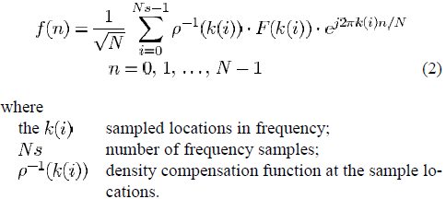

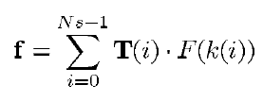


Miscellanea_ 2)Look-Up Table
In case of N equidistant point sampled signal$(ρ^{−1}=1)$
- Relationship between f(n) and F(k) can be relaxed as
,and simplified as
→ Each points of image can be calculated independently
if we set the $T(i)$ in advance
REF: Dale, B., Wendt, M., & Duerk, J. L. (2001). A rapid look-up table method for reconstructing MR images from arbitrary k-space trajectories. IEEE transactions on medical imaging, 20(3), 207-217.

Slide 12



Miscellanea_ 2)Look-Up Table
- In case of nonuniformly sampled signal
- Arbitrary k-space sampling signal
→ Each points of image can be calculated independently
if we pre-calculate the $Tg(i)$ in advance
REF: Dale, B., Wendt, M., & Duerk, J. L. (2001). A rapid look-up table method for reconstructing MR images from arbitrary k-space trajectories. IEEE transactions on medical imaging, 20(3), 207-217.

